Slide 1
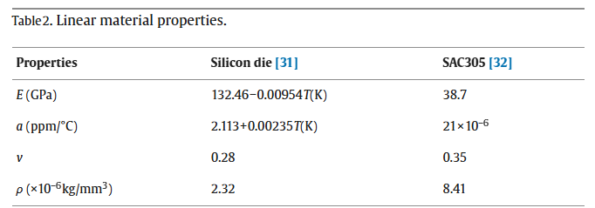
https://www.sciencedirect.com/science/article/pii/S1359431113008831#bib32
31: https://scholar.google.com/scholar_lookup?title=A%C2%A0new%20creep%20constitutive%20model%20for%20Eutectic%20solder%20alloy&publication_year=2002&author=X.Q.%20Shi
32: https://scholar.google.com/scholar_lookup?title=Effect%20of%20Structural%20Design%20Parameters%20on%20Wafer%20Level%20CSP%20Ball%20Shear%20Strength%20and%20Their%20Influence%20on%20Accelerated%20Thermal%20Cycling%20Reliability&publication_year=2010&author=N.R.%20Lakhkar

Slide 2
https://pmc.ncbi.nlm.nih.gov/articles/PMC7564005/?utm_source=chatgpt.com
https://pmc.ncbi.nlm.nih.gov/articles/PMC7564005/?utm_source=chatgpt.com
SAC 305
Density: 7.38 g/cm3
Specific heat capacity: 0.232 J/gK
SAC 305 thermal conductivity: 59 W/mK
https://arraysolders.com/wp-content/uploads/2023/06/TDS-for-Sac305.pdf
SAC305 electrical conductivity: 8.5 × 10^6 S/m

Slide 3
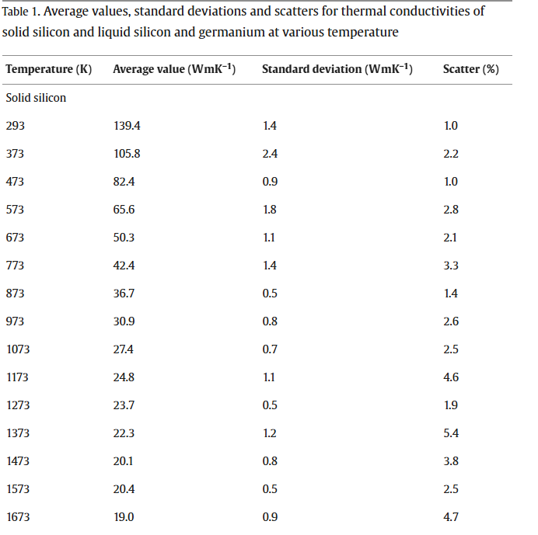
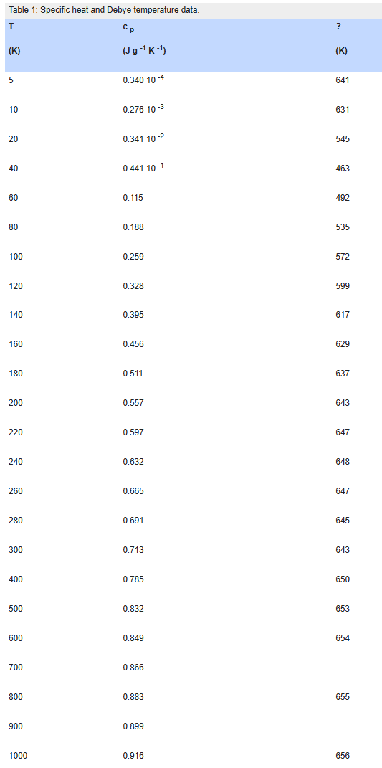
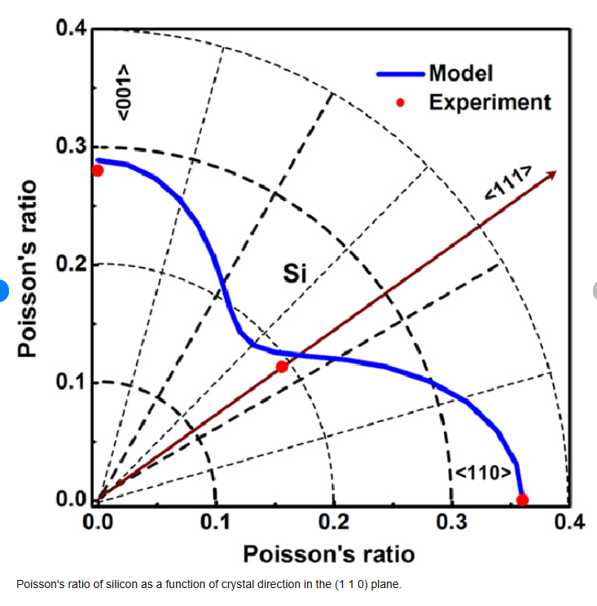
https://www.globalspec.com/reference/25095/203279/chapter-4-thermal-properties?utm_source=chatgpt.com
https://www.researchgate.net/publication/231153972_Modelling_of_the_elastic_properties_of_crystalline_silicon_using_lattice_dynamics
https://www.sciencedirect.com/science/article/pii/S0022024801016736?utm_source=chatgpt.com

Slide 4
https://www.matweb.com/search/DataSheet.aspx?MatGUID=0cd1edf33ac145ee93a0aa6fc666c0e0
https://materialsdata.nist.gov/bitstream/handle/11115/173/Aluminum%20and%20Aluminum%20Alloys%20Davis.pdf
Al density: 2.7 g/cm3
Good site for general info about aluminum

Slide 5
https://www.matweb.com/search/DataSheet.aspx?MatGUID=9aebe83845c04c1db5126fada6f76f7e
Good source for copper properties

Slide 6
https://www.digikey.com/en/products/detail/panasonic-electronic-components/EYG-S1014ZLAD/6575917
Link for graphite datasheet
Leave other material properties

Slide 7
Mica is from supplier, the only supplied constant is 3 W/mK

Slide 8
https://www.wacker.com/h/en-us/silicone-rubber/silicone-gels/wacker-silgel-612-ab/p/000007546
Silicone gel:
Density: 9.7 kg/m^3
Resistivity: 10^17 ohm-m
Permittivity: 2.7

